Slide 1
Control of an Electrically Powered Two-Spool Turbine Device Advanced Courses in Engineering 19 Jan 2017 rev. 1
Former Instructors:
Dave Gutz (rev 2017-1)
PICTURE

Slide 2
Outline
Description of Project
Wind Turbine Primer
Modeling and Linearization
Lab

Slide 3
Description of Project

Slide 4
Regulator: Subsystem or independent device that determines and maintains the operating parameters of a system, usually within certain prescribed or preset limits. Read more: http://www.businessdictionary.com/definition/regulator.html
Open-loop control can be used in systems sufficiently well-characterized as to predict what outputs will necessarily achieve the desired states. For example, the rotational velocity of an electric motor may be well enough characterized for the supplied voltage to make feedback unnecessary.
The drawback of open-loop control is that it requires perfect knowledge of the system (i.e. one knows exactly what inputs to give in order to get the desired output), and it assumes there are no disturbances to the system.
In control theory, a controller is a device, historically using mechanical, hydraulic, pneumatic or electronic techniques often in combination, but more recently in the form of a microprocessor or computer, which monitors and physically alters the operating conditions of a given dynamical system.^{[1]} ^{[2]}Typical applications of controllers are to hold settings for temperature, pressure, flow or speed.

Slide 5
Wind Turbine Primer

Slide 6
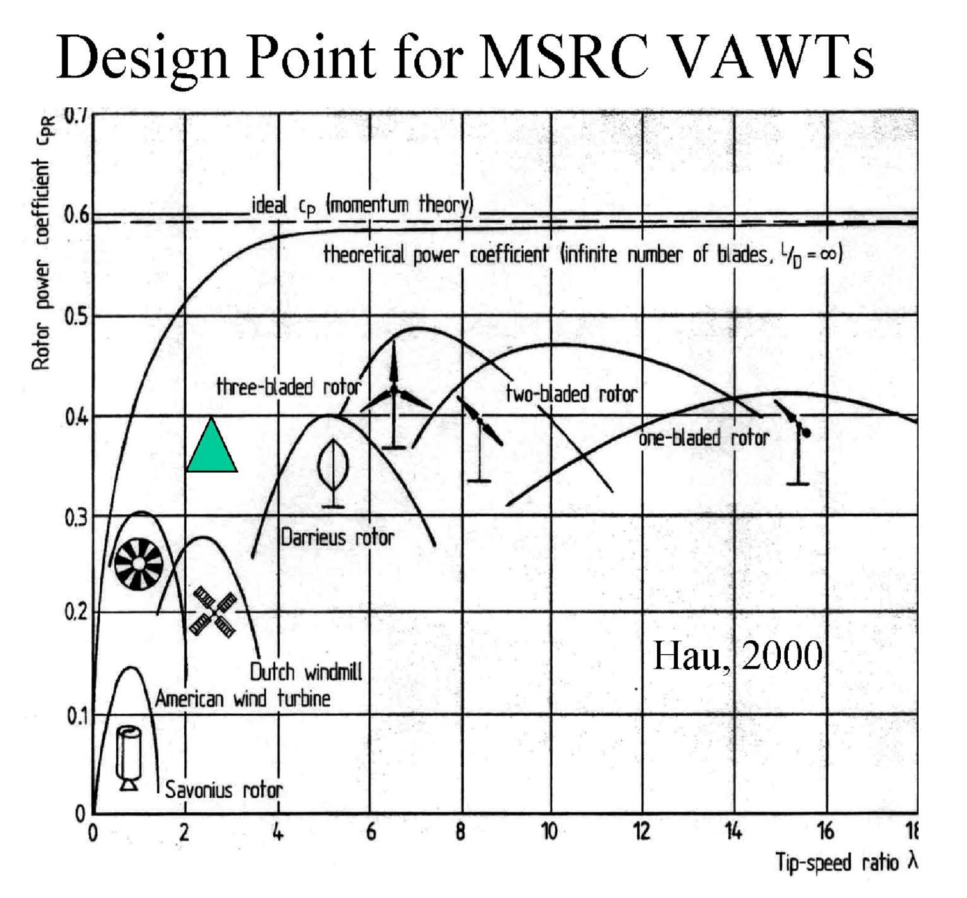
Wind Turbine Overview

Slide 7


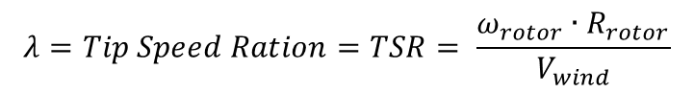
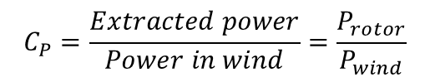
Wind Turbine Primer
$$P_{wind}=\frac{1}{2}ρA{V_{wind}^{}}_{}^{3}$$
$$P_{wind}=\frac{1}{2}C_{P}ρA{V_{wind}^{}}_{}^{3}$$
$$C_{P}=\frac{Extracted power}{Power in wind}=\frac{P_{rotor}}{P_{wind}}$$
$$λ=Tip Speed Ration=TSR= \frac{ω_{rotor}∙R_{rotor}}{V_{wind}}$$
http://www.nrel.gov/docs/fy12osti/52780.pdf
Santoso,S. and Singh, M. “Dynamic Models for Wind Turbines and Wind Power Plants,” National Renewable Energy Laboratory Publication, UT Austin, Austin, Texas, NREL/SR-5500-52780 October, 2011.
https://en.wikipedia.org/wiki/Variable_speed_wind_turbine

Slide 8
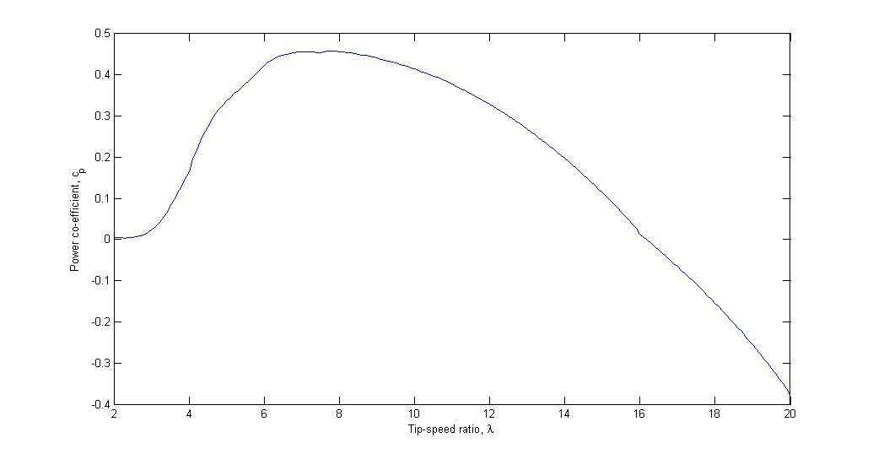
Power Coefficient Characterized by Tip Speed Ratio
Slope is related to damping torque ( N )
https://en.wikipedia.org/wiki/Variable_speed_wind_turbine

Slide 9
Get content from my white book
Get Cp curves from my personal OneNote
Assumption: neglect laminar flow Re effects

Slide 10
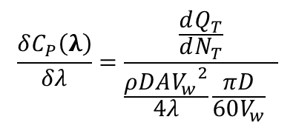
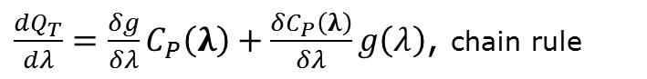
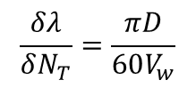
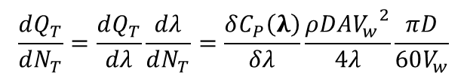
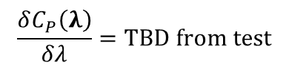
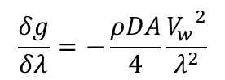
Deriving Damping from Measured Time Constant
$$Q_{T}=f\left(λ, C_{P}\left(λ\right)\right)=g\left(λ\right)∙C_{P}\left(λ\right)=\frac{ρDA}{4}\frac{{V_{w}}^{2}}{λ}C_{P}\left(λ\right)$$
$\frac{dQ_{T}}{dλ}=\frac{δg}{δλ}C_{P}\left(λ\right)+\frac{δC_{P}\left(λ\right)}{δλ}g\left(λ\right)$, chain rule
$$\frac{δg}{δλ}=−\frac{ρDA}{4}\frac{{V_{w}}^{2}}{λ^{2}}$$
$$\frac{δλ}{δN_{T}}=\frac{πD}{60V_{w}}$$
$$\frac{δC_{P}\left(λ\right)}{δλ}=\text{TBD} \text{from} \text{test}$$
$$\frac{dQ_{T}}{dN_{T}}=\frac{dQ_{T}}{dλ}\frac{dλ}{dN_{T}}=\frac{δC_{P}\left(λ\right)}{δλ}\frac{ρDA{V_{w}}^{2}}{4λ}\frac{πD}{60V_{w}}$$
$$\frac{δC_{P}\left(λ\right)}{δλ}=\frac{\frac{dQ_{T}}{dN_{T}}}{\frac{ρDA{V_{w}}^{2}}{4λ}\frac{πD}{60V_{w}} }$$

Slide 11
ESC – Electronic Speed Control of Brushless DC Motor (BLDC)

Slide 12
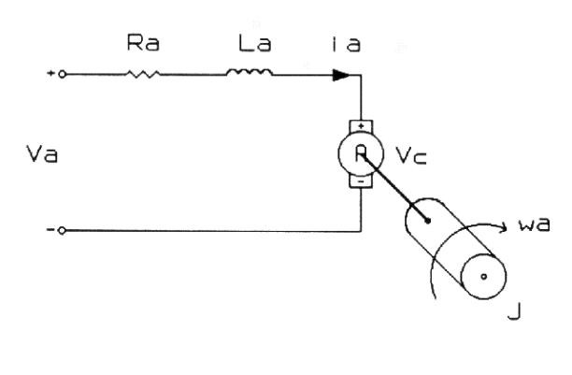
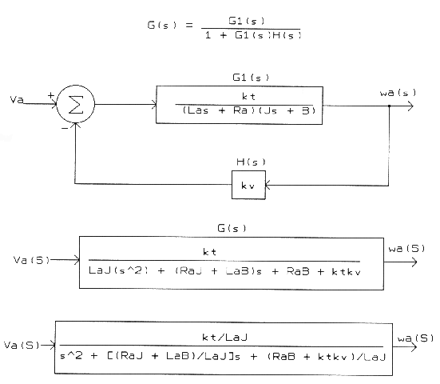
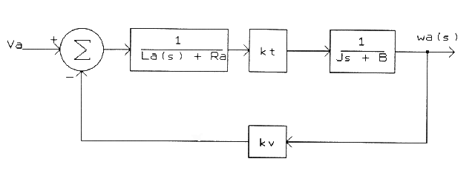
DC Motor Dynamic Model
http://www.profjrwhite.com/system_dynamics/sdyn/s6/s6fmathm/s6fmathm.html
Bandwidth > 30 Hz

Slide 13
Modeling

Slide 14
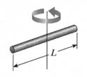
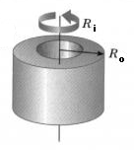
Moment of Inertia of Propeller

Slide 15
Motor Constants – SI Units Assumptions
The main thing I want you to take away from this post is that when a motor rotates it generates a back-emf. That back-emf is proportional to the motor speed and the Kv constant tells you how they relate to each othe

Slide 16
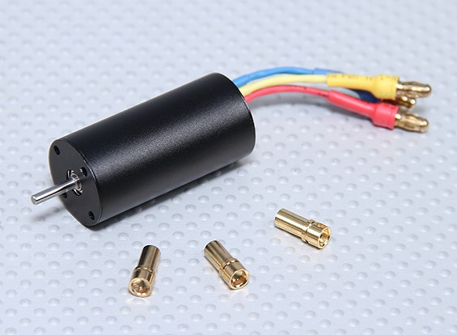
2040 Brushless Inrunner Motor 4800kv

Slide 17
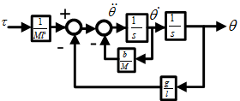
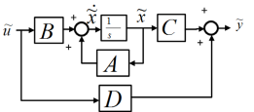
Landscape of Control System Analysis
DATA Verify
Physical System
Non-Linear Ordinary Differential Equations
Non-linearities
Modeline
Toolboxes
SISO
Matlab Tools
MIMO
Linear Analysis
Linear Differential Equations
Block Diagram
State-Space
Z-Transform
Linear
System
Beacon
Simulink-Maplesim-Labview
Shortcut
Simulink “Linearize”
Matlab
Academia
SCADE
Control
Models
Embedded
Logic
Verify
Margin
Analysis
Theory

Slide 18
Linearization
Consider a general nonlinear equation:
Suppose it has an equilibrium at (x₀ , y₀), linearize the equation about (x₀ , y₀) by expanding it into a Taylor series about x₀:
Note that if x is close to x₀ (equilibrium + small deflections):
Notes:
Equilibrium at (x₀ , y₀)—this means if you initially configure the system at this point it won’t move
Note that if x is close to x₀ then x – x₀ is small and the higher order terms can be dropped

Slide 19
Linearization (continued)
can be turned into a linear equation via a change of variables:
Where Δy = y – y₀ and Δx = x – x₀ . Note that
Linearized equations only valid close to equilibrium
Different equilibrium point means different linear equations
Notes:
Taylor Series’ method can be generalization using the Chain Rule

Slide 20
Linearization Example
Consider a simple pendulum with applied torque τ :
Physical System
τ
θ
l
b
M
⇒
Nonlinear Differential Equations
The equation of motion is:
⇒
Linear Differential Equations
Notes:
You know by inspection that the system has two equilibrium points: $θ=0$and $θ=π$
The one at 0 is stable. The one at the top is unstable. The linearization process should reveal this.

Slide 21
Linearization Example – deep dive
Want to linearize
about
so we have

Slide 22
Linearization Example – deep dive
Drop the “delta” symbols to an implied “delta model”
And apply the initial conditions at the known stability points:

Slide 23
Linearization Example
Consider a simple pendulum with applied torque τ :
Physical System
τ
θ
l
b
M
⇒
The equation of motion is:
Nonlinear Differential Equations
The Linear Differential Equations at two natural stability points are:
⇒
Linear Differential Equations
Notes:
You know by inspection that the system has two equilibrium points: $θ=0$and $θ=π$
The one at 0 is stable. The one at the top is unstable. The linearization process should reveal this.

Slide 24
Exercise #1
Open Matlab R2013A or later
Enter the following at the command line:
g = 32.2; % Gravity, ft/sec^2
l = g*(1/(2*pi))^2; % Pendulum length for 1 sec period, ft
b = 0.01; % Damping, lbf/(ft/sec)
d = 1; % Diameter steel pendulum sphere, in
M = 4/3*pi*(d/2)^3*.3/g; % Mass of ball, slugs
Tpulse = 1; % Pulse time, sec
Hpulse = 10; % Pulse height, ft-lbf
Dpulse = 0.1; % Pulse duration, sec
Open a new Simulink diagram. Save it as “myPendulum.slx”
Open “ClassroomLibrary.” If no icons appear, then make sure the “SimulinkLibrary” folder is present and try again.
Draw the system using the blocks available in the Library
Connect the Impulse source and scope to the system. Run it. Save it. Is the observed natural period 1 second?

Slide 25
Transfer Functions

Slide 26
Progress – Model to Linear D.E.
Physical System
⇒
Nonlinear Differential Equations
⇒
Linear Differential Equations
⇒
Transfer Function
l
θ
M
Notes:
The goal is Transfer Functions

Slide 27
An Aside: State Space
Recall Taylor Series Expansion of Partial Differential Equation
It is common to separate internal and external influences. This allows Eigenvalue analysis (states) separate from Boundary Value solutions.
Abbreviate
Notes:
State Space is extremely useful as a bridge between different kinds of analysis tools.

Slide 28
State Space Continued
Accompanying any dynamical system will be a set of O.D.E.s describing the equations of motion:
Further generalize the internal states, x. Note that ANY state has a value and a derivative. The second derivative is the derivative of the state representing the first derivative, and so on:

Slide 29
State Space Continued
Now a general single-input, single-output (SISO) dynamical system will have a system of equations as it’s general representation.
Define some small letters to clean up the nomenclature:

Slide 30
State Space Concluded
In general, all the parameters are vectors or arrays with all sorts of real-world cross-coupling and will be multi-input, multi-output (MIMO).

Slide 31
This “State” Concept Can Be Leveraged to Create a Nice Block Diagram Connection. If this all seems a mish-mash it is. These are different symbols for representing the same concept. In fact, a Bode plot is another symbol.

Slide 32

How it All Connects – these are all mathematically equivalent
ODE
Complex derivations
Math ‘engine’
Physically intuitive
MIMO shorthand
GUI Application
MIMO shorthand
GUI Application
Control Intuitive (Bode bridge)
DSP connection by Fourier

Slide 33
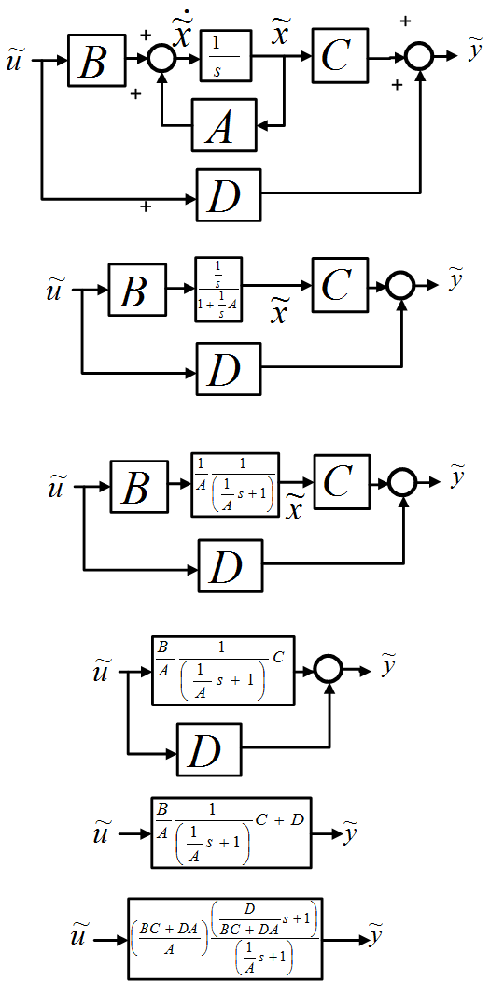
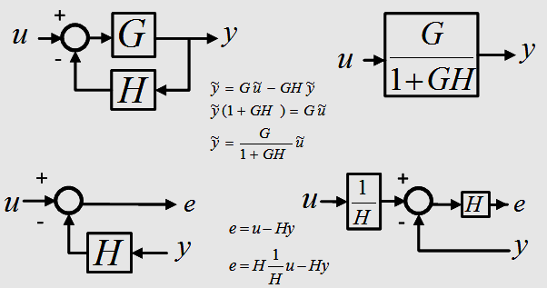
Example: Derivation of Transfer Function from Block Diagram
These are all the clues you need to know.
Block diagrams are drawings of algebraic equations.

Slide 34
Example Cont’d - Transfer Function
Consider a simple pendulum with applied torque τ :
τ
θ
l
b
Physical System
M
⇒
The equation of motion is:
Nonlinear Differential Equations
⇒
Linearize and apply at the bottom dead-center:
Linear Differential Equations
⇒
A transfer function can now be derived:
Transfer Function

Slide 35
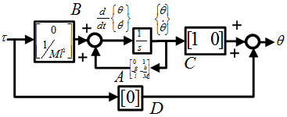
Conclusion – Model to LTI
Physical System
⇒
Nonlinear Differential Equations
⇒
Linear Differential Equations
⇒
Transfer Function
τ
θ
l
b
M
⇒
⇒
Block Diagram
⇒
State-Space
Control Design
Notes:
More on this later. Draw in Simulink now?

Slide 36
In-Class Exercise:
Draw pendulum in Simulink
Generate time response; verify period of oscillation
Repeat in Matlab using SS. Use CL and functions to verify Simulink result
Repeat in Matlab using LTI.....Verify Eigenvalues. Make LTI steps and Bodes

Slide 37
Frequency Response

Slide 38
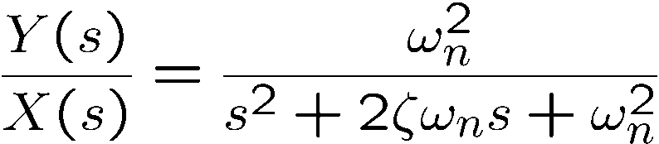
Types of Responses
Consider a typical second order system:
where ω_{n} = 10 and ζ = 0.3
The following responses are presented on the next slide:
Unforced response (with initial condition)
Impulse response
Step response
Sinusoidal response
From now on we're going to concentrate on the sinusoidal or “frequency response.”

Slide 39
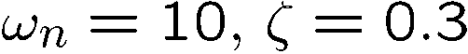
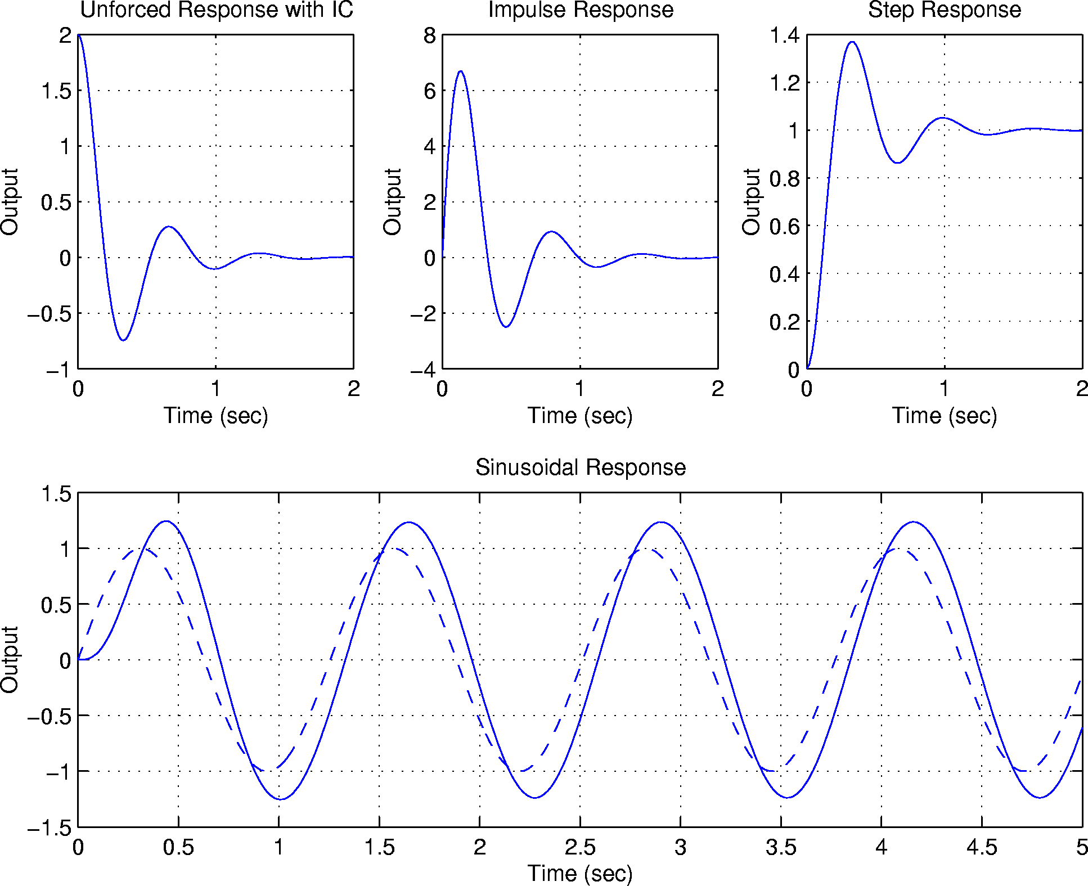
Do all these examples in Simulink during class. Figure out a streamlined way to do it, e.g. interactive script that pages through

Slide 40
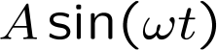
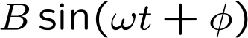
The Frequency Response
What is it?
If a stable linear time invariant system is driven with a steady sinusoidal input, the output will be another sinusoid of the same frequency but with a different amplitude and phase shift.
The frequency response of the system relates the output sinusoid
amplitude and phase shift to that of the input:
H (LTI Sys)
In dynamic systems both the ratio B/A and the phase angle φ are functions of the frequency ω .

Slide 41
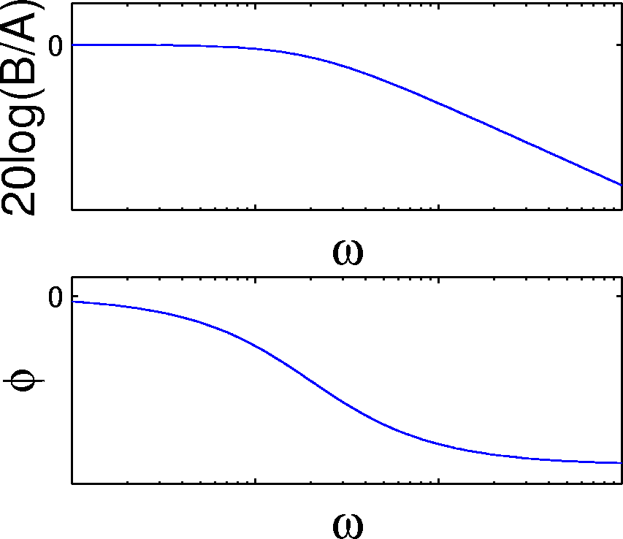
What is Frequency Response (continued)
A Bode plot shows the complete picture of B/A and φ :
Note that the frequency axis is a log scale, and the magnitude is measured in decibels. This allow the response to be estimated as a series of straight lines. Also note the shape:
Amplitude ratio rolls off as frequency increases
Phase angle is negative
This is typical of physical systems
They are often low pass—high frequencies are attenuated
They exhibit phase loss or phase lag

Slide 42
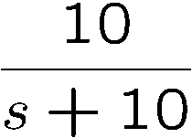
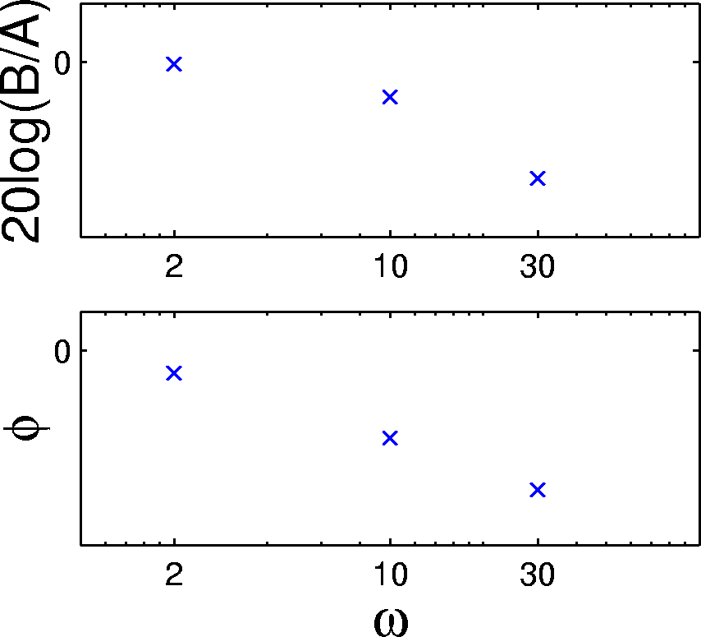
What is Frequency Response (continued)
Let’s look at some sinusoidal responses of
Note that as frequency gets large the output cannot keep up:
Do all these examples in Simulink during class. Figure out a streamlined way to do it, e.g. interactive script that pages through

Slide 43
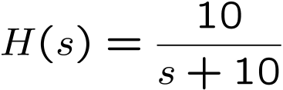
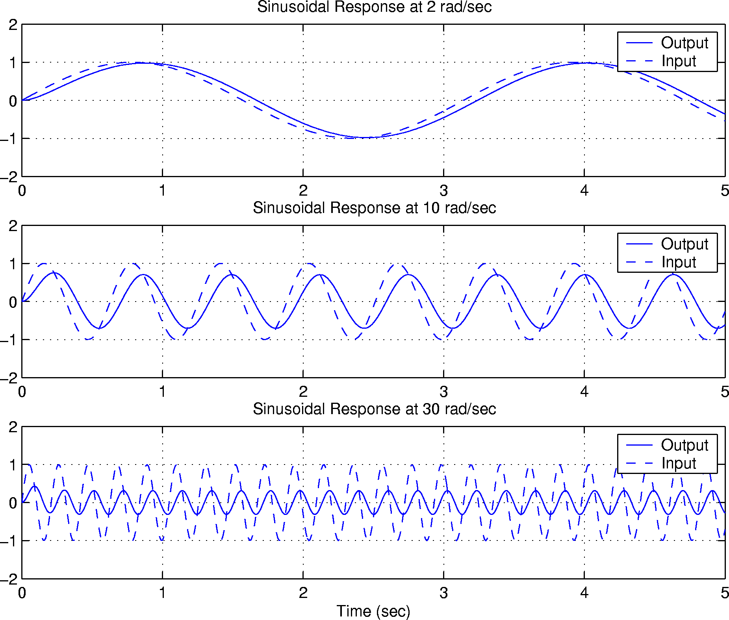
Do all these examples in Simulink during class. Figure out a streamlined way to do it, e.g. interactive script that pages through

Slide 44
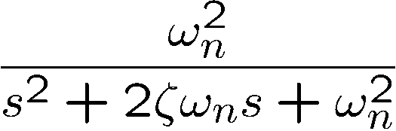
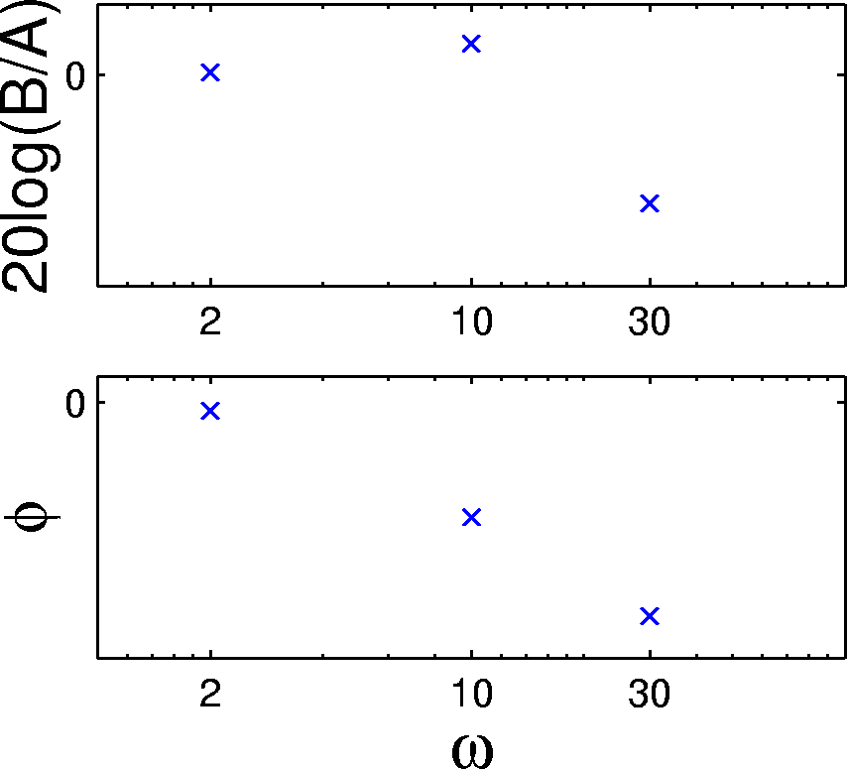
What is Frequency Response (continued)
Resonant systems have a frequency range where the output is amplified
Consider sinusoidal responses shown on the next page for
where ω_{n} = 10 and ζ = 0.3
Note the amplification at ω = 10 which is at the natural frequency of the system:

Slide 45
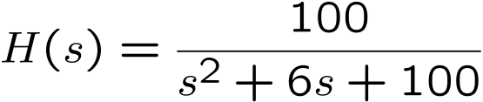
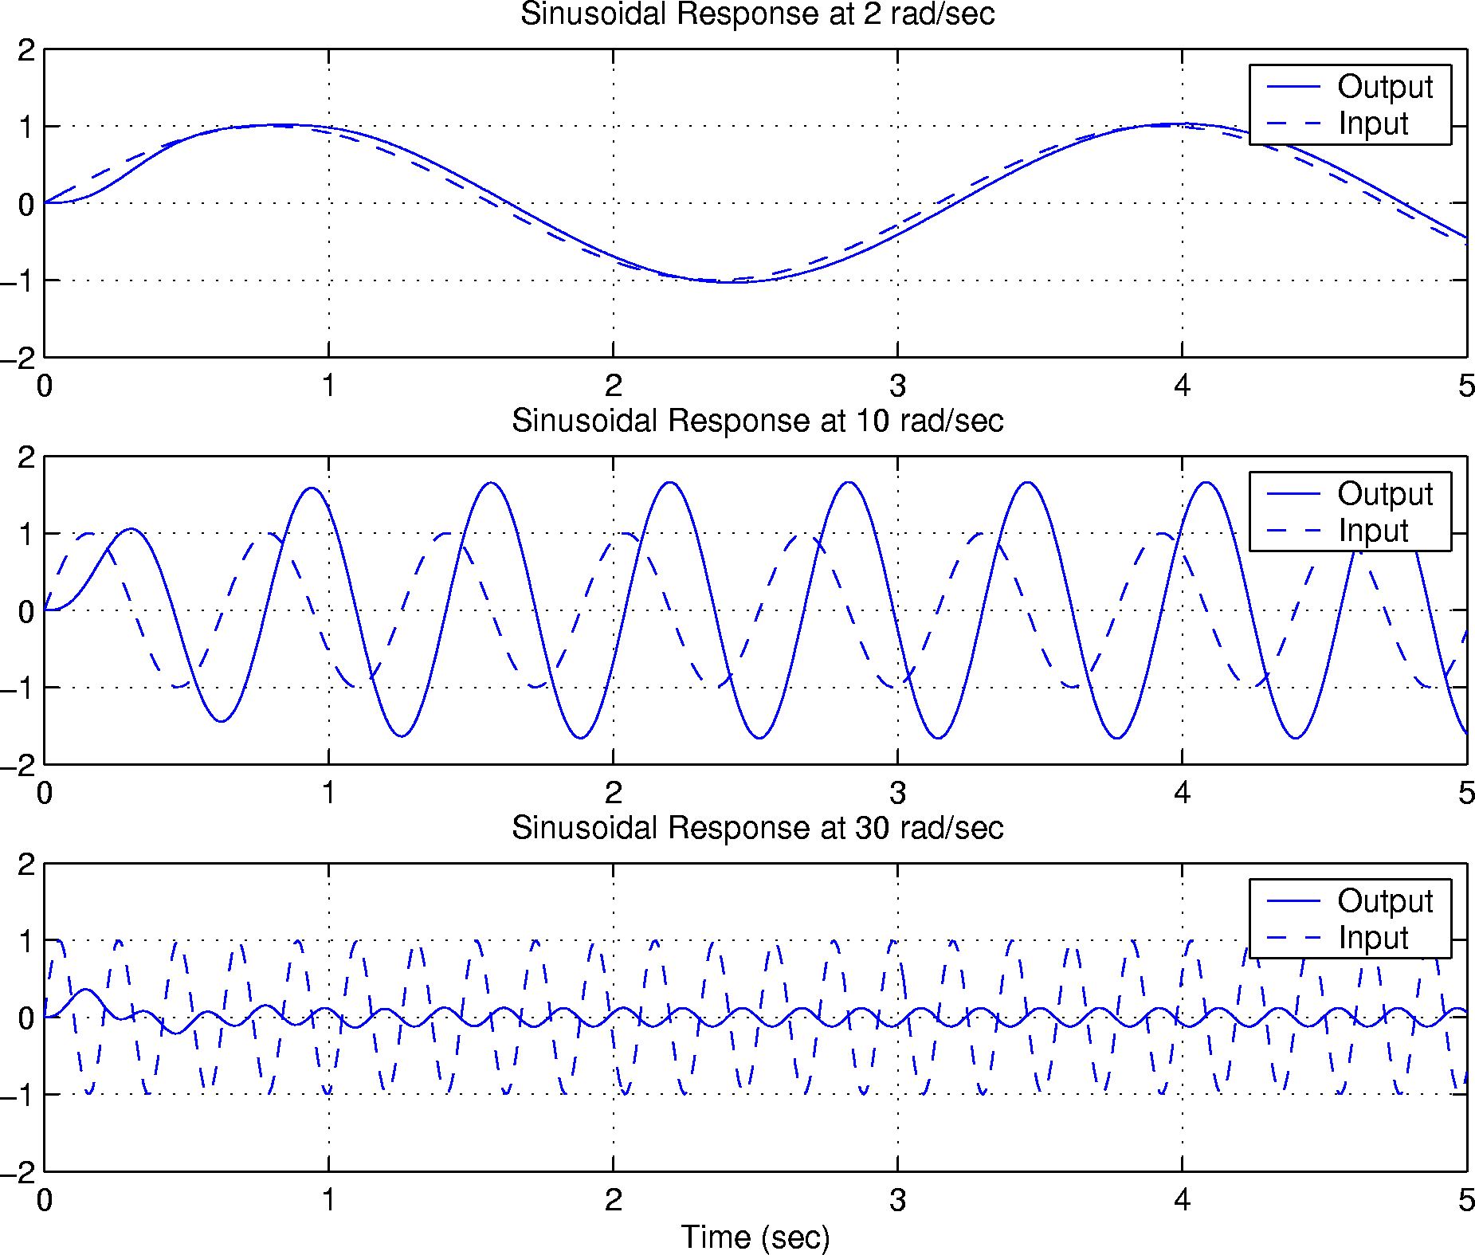
Do all these examples in Simulink during class. Figure out a streamlined way to do it, e.g. interactive script that pages through

Slide 46
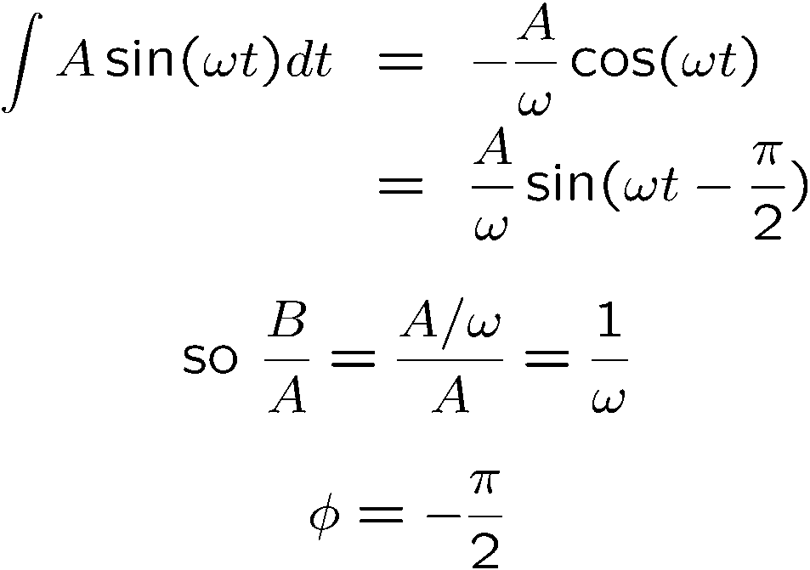
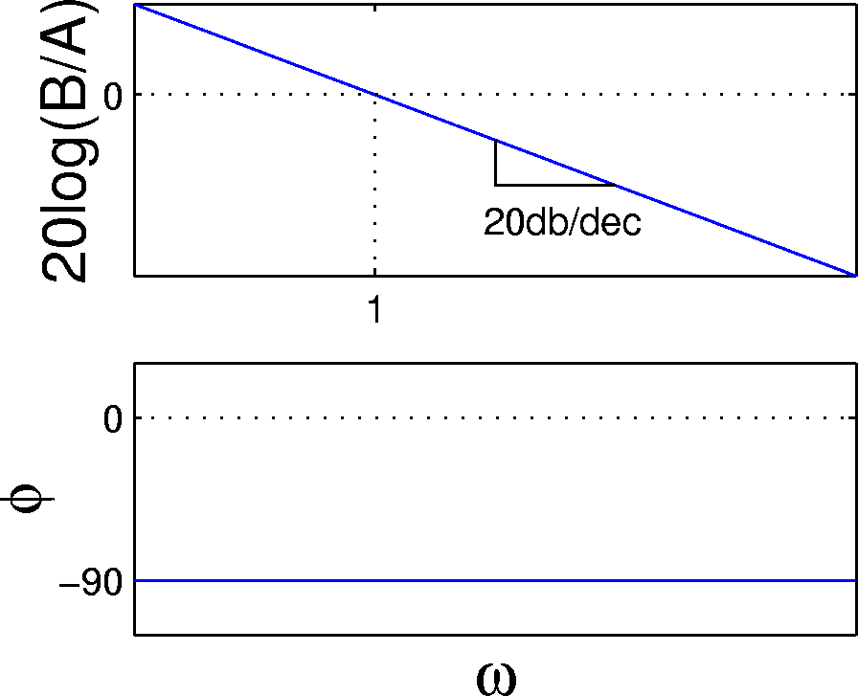
Integrator Frequency Response
Compute B/A and φ analytically:

Slide 47
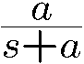
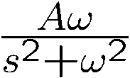
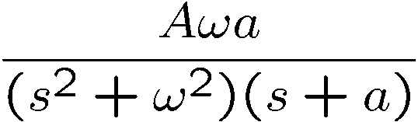
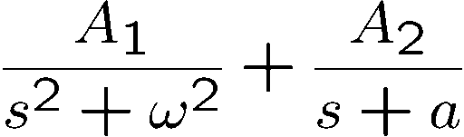
Lag Frequency Response
Compute B/A and φ analytically by figuring out the response to a sine wave:
Laplace transform of A sin(ω t) (for t>0) is
So the output Laplace transform is
Expanding partial fractions yields:
output sinusoid
transient (goes away)
So by figuring out a formula for A₁ you could at least get the magnitude response… COULD THERE BE A BETTER WAY???

Slide 48
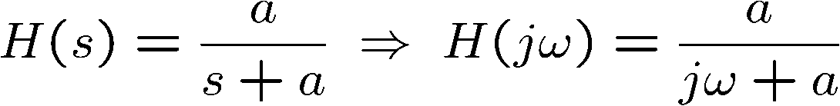
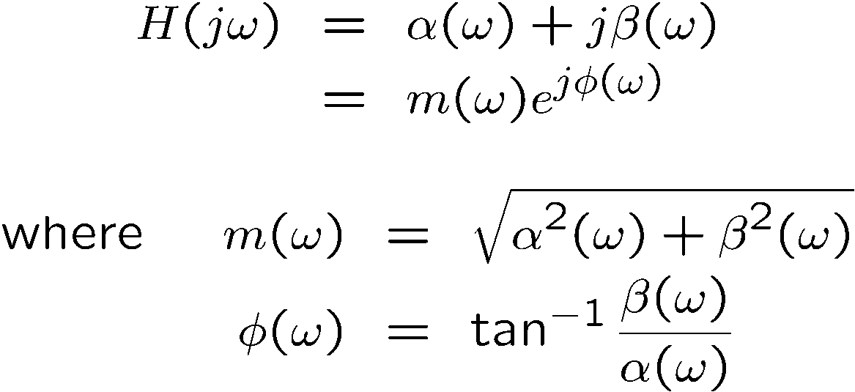
Lag Frequency Response (continued)
So… A better way to compute the lag frequency response involves looking at the transfer function in terms of the Fourier transform.
Let’s limit the Laplace variable s to just the imaginary axis, so s = jω
Note that H(jω) is a complex number that can be represented by a magnitude and a phase angle:

Slide 49
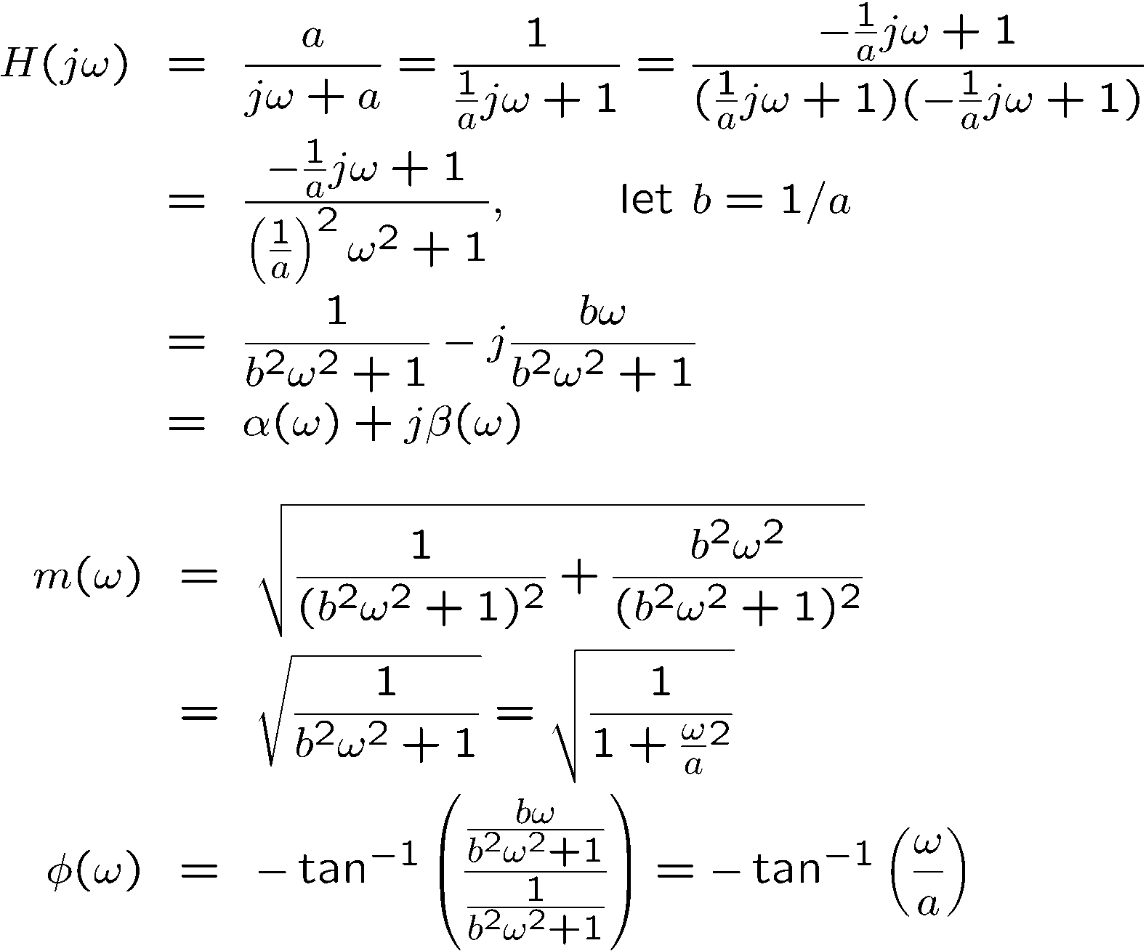
Lag Frequency Response (continued)
So let’s compute m(ω) and φ(ω) :

Slide 50
Excel Frequency Response Example
Use complex number functions:
COMPLEX(sigma, beta)
IMSUM(<complex>,<complex>,…)
IMPRODUCT(<complex>, <complex>,..)
Mag = IMABS(<complex>)
Phase = IMARGUMENT(<complex>)*180/PI()
Second order system gain=1/ IMABS(COMPLEX( 1-w^2/wn^2, 2*z*w/wn))
Phase= -IMARGUMENT(COMPLEX( ))*180/PI()

Slide 51
MATLAB Frequency Response Example
MATLAB is object-oriented. It knows what you’re trying to do.
Use SYSTEM functions:
<tfPoly> = [a b c d];
<sysTF> = tf(<numPoly>, <denPoly>)
<sysSS> = ss(<sysTF>)
<sysTF> = tf(<sysSS>)
<OLTF> = G*H
<CLTF> = G/(1+GH)
Figure; step(<CLTF>)
Figure; bode(<OLTF>)
Second Order example
num = 1
den = [1/wn^2 2*z/wn 1]
sys2 = tf(num, den)
sys2SS = ss(sys2)

Slide 52
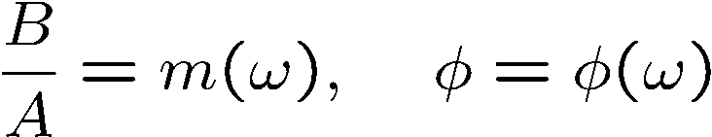
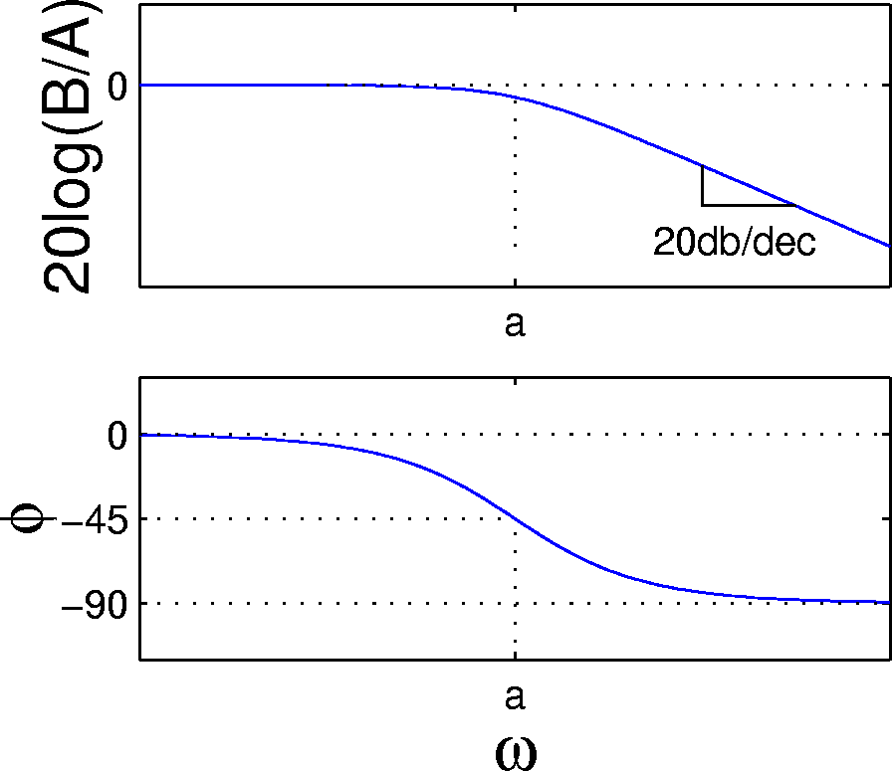
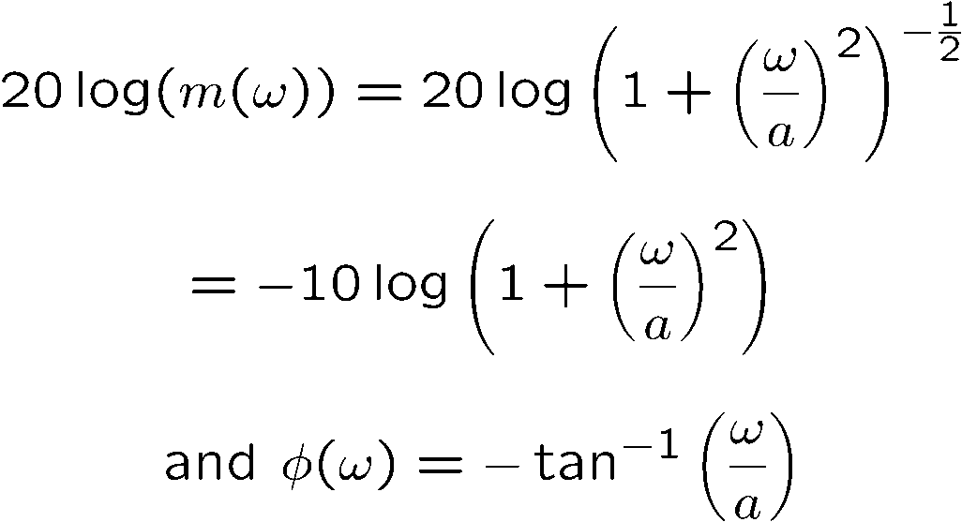
Lag Frequency Response (continued)
For a pure sinusoid input with amplitude 1 and zero phase, the magnitude and angle of H(jω) can be used to directly compute B/A and φ that we originally wanted:
Do all these examples in Simulink during class. Figure out a streamlined way to do it, e.g. interactive script that pages through
Since Bode plots use decibels:

Slide 53
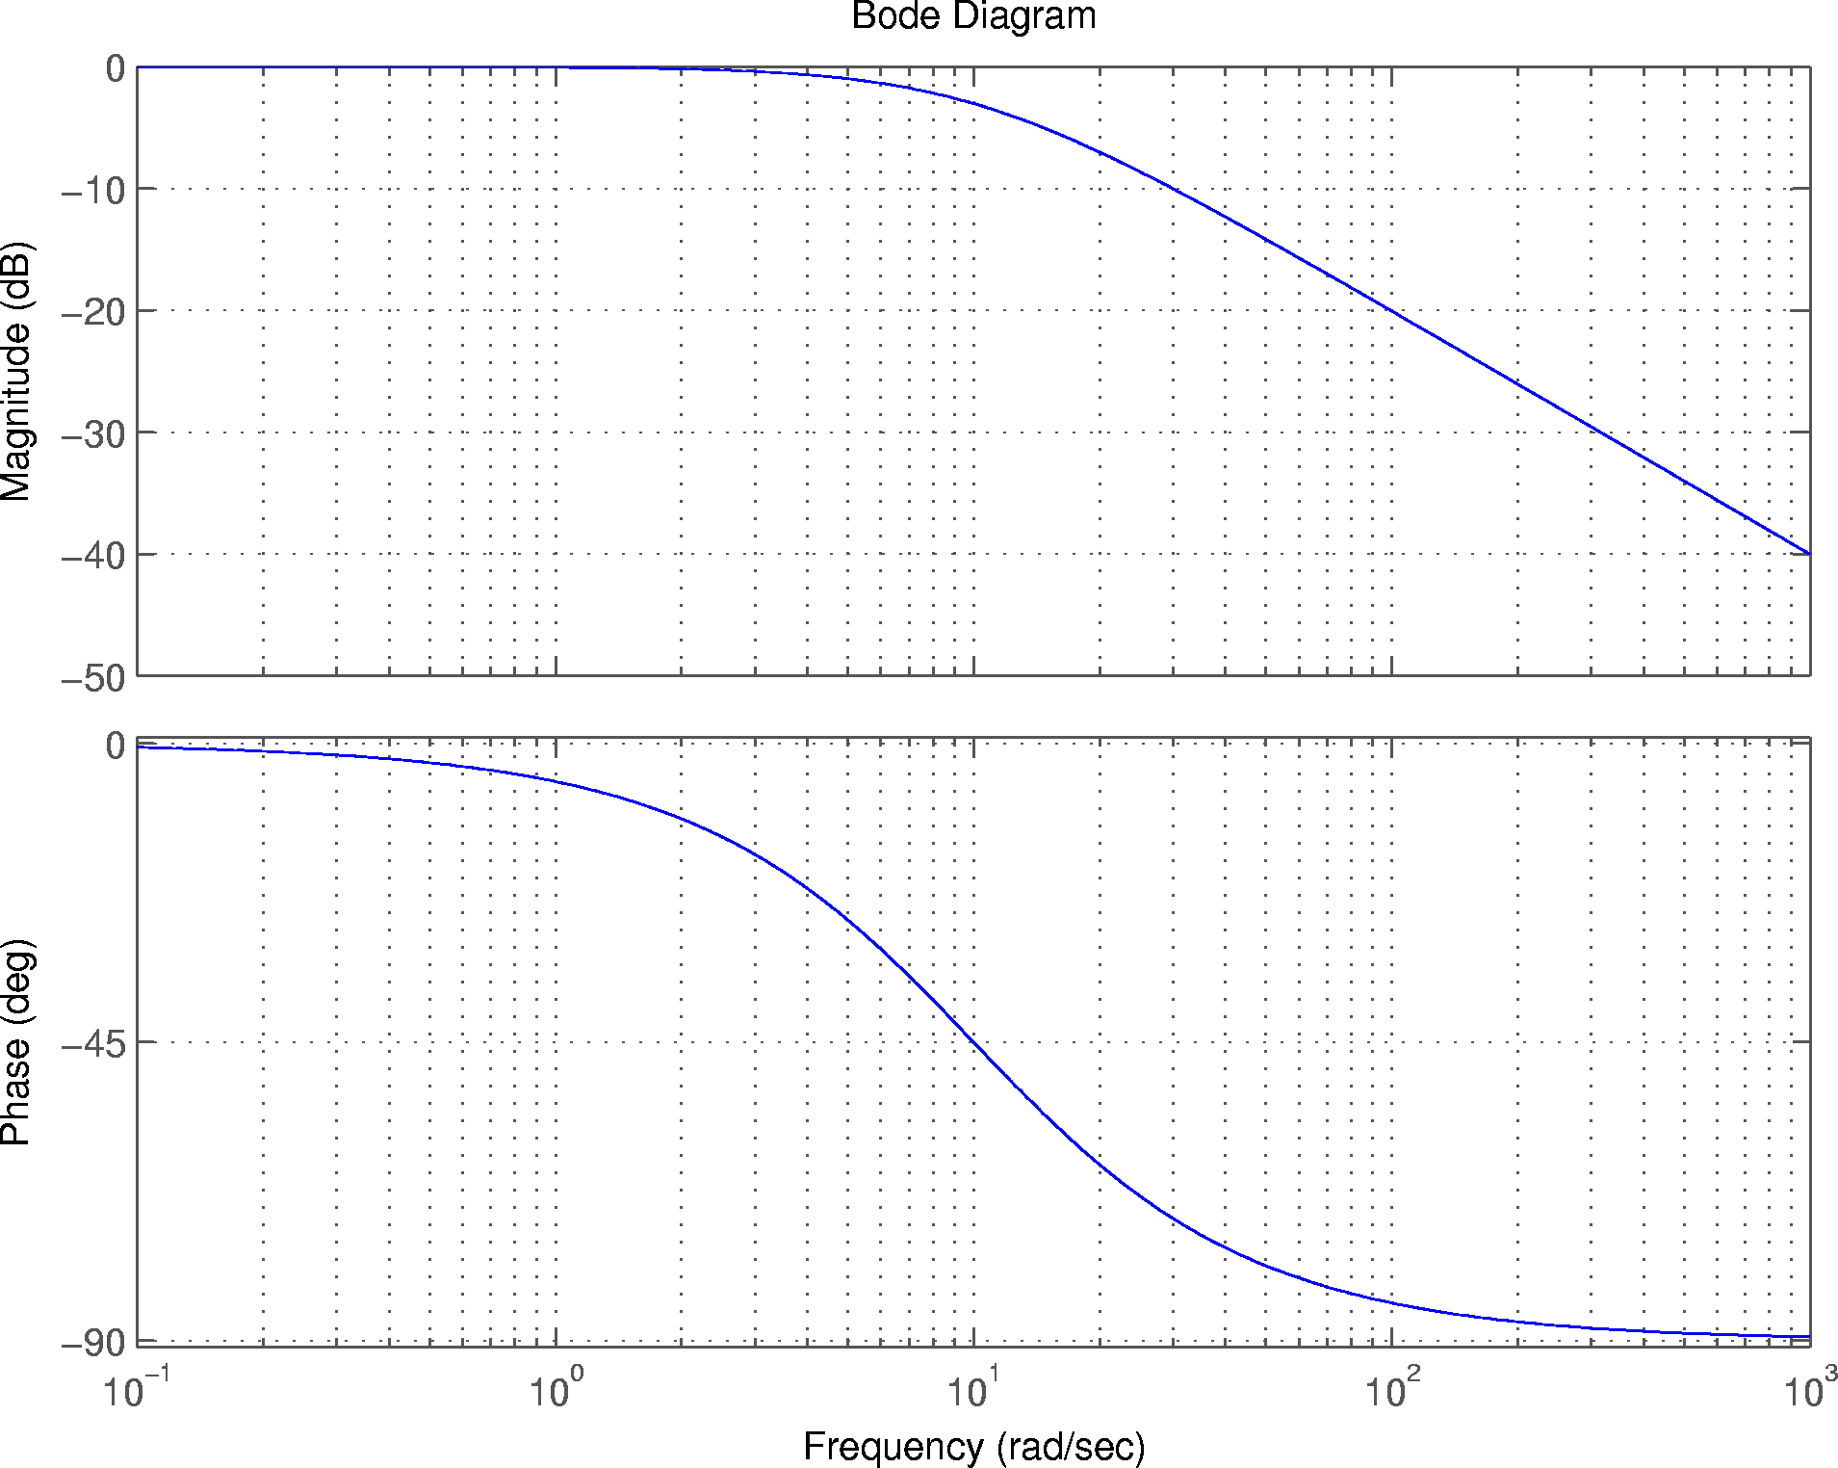
Do all these examples in Simulink during class. Figure out a streamlined way to do it, e.g. interactive script that pages through

Slide 54
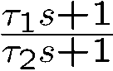
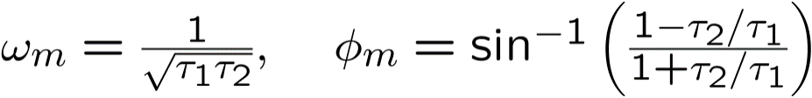


Lead/Lag Frequency Response
Results for two cases:
Do all these examples in Simulink during class. Figure out a streamlined way to do it, e.g. interactive script that pages through

Slide 55


Do all these examples in Simulink during class. Figure out a streamlined way to do it, e.g. interactive script that pages through

Slide 56

Do all these examples in Simulink during class. Figure out a streamlined way to do it, e.g. interactive script that pages through

Slide 57


Slide 58



Slide 59


Second Order Frequency Response
Frequency response shape depends heavily on value of ζ

Slide 60


Do all these examples in Simulink during class. Figure out a streamlined way to do it, e.g. interactive script that pages through

Slide 61


Pure Delay Frequency Response
Do all these examples in Simulink during class. Figure out a streamlined way to do it, e.g. interactive script that pages through
Sampled data systems appear to have output delayed by half the sample rate.
Pure delay has no impact on gain but phase loss goes to infinity at high frequencies.

Slide 62



Frequency Responses are Additive
Do all these examples in Simulink during class. Figure out a streamlined way to do it, e.g. interactive script that pages through
This is because logs of magnitudes (and phases) add when you multiply complex numbers together. Very convenient…

Slide 63
Closed Loop Transfer Function

Slide 64






Loop Transfer Function/Closed Loop Transfer Function
Need to be aware of two definitions
+
K(s)
G(s)
-
H(s)
The Loop Transfer Function is the transfer function you get if you break the feedback loop at the last possible point; in the above diagram it’s the TF from e(t) to x(t):
The Closed Loop Transfer Function is just the transfer function from r(t) to y(t):
Note that the CLTF tends to be more complex than the loop transfer function, parameters from controller more tangled up.

Slide 65

Using the Open Loop TF to Infer CLTF Poles
Recall that the CLTF poles always satisfy:
Where G_{l}(s) is the loop TF
Crudely put*, when the open loop transfer function reaches or exceed the condition of -1 (180 degrees at 0 dB) the system becomes unstable.
Intuitively this means that the control action large enough to amplify (re-enforce) an out of phase response
Notes:
*Technically, when the open loop transfer function encircles the -1 point on a Nyquist diagram of phase versus magnitude.

Slide 66
Gain and Phase Margin on Bode Plot
Margins best visualized on Bode plot of open loop transfer function
Gain Crossover (“the crossover”)
Magnitude
Gain Margin
0 dB
Phase
-90
Phase Crossover
Phase Margin
-180
If either margin is zero or negative, system is unstable. This is this lecture’s definition of instability.
REMEMBER: THIS IS THE OPEN LOOP TRANSFER FUNCTION
Notes:
Phase Margin is the difference in phase between G_{l}(jω) and –180 degrees when the magnitude of G_{l}(jω) is 1 (0 dB)
Gain Margin is the difference between the magnitude of G_{l}(jω) and 1 (0 dB) when phase is –180 degrees (how much would we need to multiply G_{l}(jω) to get 1)
Consider a real world control:
Gain of open loop system is the product of the compensator gain and the plant gain. We know the compensator gain (we designed it, but the plant gain comes from a model.
So gain margin tells is how much the actual plant gain can be different from our model without causing instability
Gain margin requirement for a control design is chosen based on our confidence in our model
E.g. for an engine how well do we know ∂ Q_{u} /∂ w_{f} ?
Typical choice is 6dB (a factor of two)
Phase margin tells us the same thing for model uncertainty in dynamics and delays

Slide 67
Relationships Between Open and Closed Loop Frequency Responses and Time Response
Open Loop Frequency Response Characteristics:
Gain Crossover (where gain crosses 0 dB)
*Phase Crossover (where phase crosses –180 deg)
Gain Margin
*Gain Rolloff Margin
Phase Margin
*Delay margin (number of delays at sample rate to destabilize)
Closed Loop Frequency Response Characteristics:
Gain Bandwidth (where gain hits –3 dB) not crossover
Phase Bandwidth (where phase hits –45 deg) not crossover
Peaking – caused by “near” instability e.g. low margins
Time Response Characteristics:
Rise time
Settling time
Overshoot
Other Characteristics:
Pole location (for real poles)
Natural Frequency and Damping (for complex poles)
Notes:
*Seldom used

Slide 68

Relationships Between Open and Closed Loop Frequency Responses and Time Response (continued)
Have already seen these relationships:
High bandwidth ⇔ Fast rise time High natural frequency High pole location
High peaking ⇔ Faster rise time High overshoot Slow settling time Low damping
Now we can add the open loop relationships:
High gain crossover ⇔ High bandwidth
High phase margin ⇔ Low peaking High damping
In fact, for second order systems:

Slide 69
Control Design

Slide 70
Control Design Objectives
Objectives of control design are twofold:
Performance
Rise and settling time
Overshoot
Bandwidth ⇔ crossover
Robustness
Gain margin
Phase margin
To achieve robustness objectives need to shape open loop frequency response
Since open loop crossover relates to performance it is convenient to use open loop frequency response as vehicle for control design
Typical design objectives…
Target phase margin of 55 degrees
Target crossover of 3 rad/sec
Min gain margin of 6 dB
Notes:
There are no DP requirements in 2014 for gain margin and phase margin.

Slide 71




Lead Compensation Example
Consider an uncompensated plant:
Too slow (crossover too low)
Negative phase margin at target crossover
Step 1: Choose unity gain lead/lag compensator to build needed phase at target crossover
Notes:
Lead adds phase and gain → lower loop gain to re-establish crossover frequency.

Slide 72


Lead Compensation Example (continued)
Combine unity gain compensator with plant (linear superposition applies here)
Note that compensator does indeed boost the phase such that phase margin is now acceptable. What about gain bandwidth?

Slide 73


Lead Compensation Example (continued)
Step 2: Choose compensator gain to hit target crossover
So now our combined compensator and plant has the desired crossover and phase margin.
Now we can go look at the closed-loop frequency response and time response to verify the design.

Slide 74
Lead Compensation Example (continued)
Final Note: By designing the lead compensator we have hit both performance and robustness objectives
ω_{c} ⇒ bandwidth ⇒ rise time
PM ⇒ stability ⇒ low overshoot

Slide 75


Notional Ideal Control System
The most desirable dynamic behavior: first order lag
Do these cancel?
Why not or why?
Notes:
Infinite gain margin
90 degrees phase margin
Simply raise the gain as much as can be tolerated/supported by the hardware
The cancellation activity raises the power level inside the loop potentially reaching hardware limits at low gains.
Still a worthy notion

Slide 76
Control Design Example Summary

Slide 77
Frequency Domain Control Design Example Summary
Let’s use what you’ve learned to review the process for example #2
Physical System
⇒
Nonlinear Differential Equations
⇒
Linear Differential Equations
⇒
Transfer Function
⇒
⇒
Control
Design
⇒
Verify
Model
Implement Model
⇒
-Requirements
-Trade studies
-Another model
-Test
Control Design
Iterate as needed
Notes:
Block Diagram → Derive plant time constant
Matlab LTI Systems
Linear analysis
Architecture
Stability margins
Control response optimization
Simulink
Non-linear simulation
Linear model generation
Verification
Drive with test data
Shareable with customers/suppliers
Structure standardization
Matlab command line (“cli”)
Automation/scripting
All Matlab commands and gui’s have a cli
Matlab State-space
Eigenvalue analysis; modal analysis
Various Matlab Tools
Automated tuning
Method repository

Slide 78

Example Conclusion – Close the Loop!
Physical System
⇒
Nonlinear Differential Equations
⇒
Linear Differential Equations
⇒
Transfer Function
τ
θ
l
b
M
⇒
⇒
⇒
Block Diagram
⇒
Control
Design
Frequency Response
(sisotool)
State-Space
Root Locus
open
b2
b3
b1
closed
b4
b5

Slide 79


Rigid Pendulum Closed Loop Controller System Block Diagram
Added the assumption that the pendulum is rigid
Control
Design
Plant poles at +/-5.65 r/s
Strategy 1: Use Matlab’s built-in LQG tool

Slide 80

Result Using sisotool for Air/Water Damping, Optimal Design Compensator
Control
Design
Trade study
Automatic tuning seeks zero to cancel;
Fast poles to “carry” the leads”
Gain=0.587
Zeros at 5.6, 1.5 r/s
Poles at 0, 0, -42+/-42j
Gain Margin = 13.5 dB, 53.8 r/s (8.5 Hz)
Phase Margin = 44.4 deg, 17.2 r/s (2.7 Hz)
Settles to 95% in ~4sec
Notes:
Open R2013A or later.
% Bode design of regularPendulum
open('regularPendulum.mdl')
% This will automatically generate some Bode plots for reference and make assignments for later use:
sim('regularPendulum.mdl')
%
% scope will show all possible systems’ time responses
%%%%%%%%%%%%%%Command Line Basics%%%%%%%%%%%%
generated by File-Model Properties – Callbacks – InitFcn
LTI_Direct = SS = ABCD = LTI_Alg
%%%%%%%%%%%%%% Tools%%%%%%%%%%%%%%%
% Examine plant:
Analysis – Control Design – Linear Analysis – Exact Linearization - <pencil, pick i/o> - new Bode
Rename linsys1 to “plant”. Drag to MATLAB: workspace
Eig(plant)
0+/-5.6545i
% SisoTool start from command line
sisotool
Architecture – System Data – G=SS, H=1, C=Controller, F=1 (generated by File-Model Properties – Callbacks – PreLoadFcn)
% Can move zeroes and poles on lrc plot
% Used Automated Tuning – LQG Synthesis – default settings – 3rd order
% Linear Analysis
Analysis – Control Design – Linear Analysis Tool
Select ContComp as Open-loop Input and LTI Direct as Output Measurement
Rename system to ‘linsysLTI_Direct’ and drag to MATLAB workspace
figure(1); hold; bode(linsysLTI_Direct) % SAME!!
Select Sum1 as open-loop Input and Integrator2 as Output Measurement
Run new Bode and right-click – Characteristics – Margins to show gain margin and phase margin
% alternatively
Figure; bode(OLTF);

Slide 81

Canceller Study
Strategy 2: Next try cancelling the plant (the best we can) and maximize K for best closed loop
Notice that we’re using physical reasoning to design a controller
Control
Design
Notes:
% Use Matlab R2013a or later
open('regularPendulumCancel.mdl')
% This will automatically generate some Bode plots for reference and make assignments for later use:
sim('regularPendulumCancel.mdl')
tf(plant)
From input "torque, ft-lbf" to output "theta-rad":
205
------------------------
s^2 + 6.038e-05 s + 32.2
tf(Canceller)
s^2 + 6.038e-05 s + 32.2
--------------------------
0.0631 s^2 + 5.035 s + 205
% Analysis – Control Design – Linear Analysis
Alternate various i/o to create the “compensator plot”

Slide 82


Redo Linear Design with Reduced Order Controller (canceller)
Control
Design
Gain Margin = inf
Phase Margin = 141 deg
Settles in ~1.8sec (3x improvement)
Some noise evident! Cancellation artifacts.
Gain=3.1 (HIGH!!)
1st order Compensator ‘unloaded’ by Canceller
Notes:
% Use Matlab R2013a or later
open('regularPendulumCancel.mdl')
% This will automatically generate some Bode plots for reference and make assignments for later use:
sim('regularPendulumCancel.mdl')
tf(plant)
From input "torque, ft-lbf" to output "theta-rad":
205
------------------------
s^2 + 6.038e-05 s + 32.2
tf(Canceller)
s^2 + 6.038e-05 s + 32.2
--------------------------
0.0631 s^2 + 5.035 s + 205
% SisoTool start from command line
sisotool
Architecture – System Data – G=Canceller*SS, H=1, C=Controller, F=1 (generated by File-Model Properties – Callbacks – PreLoadFcn)
% Can move zeroes and poles on lrc plot
% Used Automated Tuning – LQG Synthesis – default settings –1st order

Slide 83



Cautions – Which do you prefer? Which do you need?
Aggressive cancellation: control signal large. Power larger. Noisier.
Susceptible to variation – especially 2nd order. (Not really a problem for first order compensation)
Control
Design
1.25 ft-lbf peak
125 ft-lbf peak

Slide 84
Let’s Talk about Damping – Making it Simple
A very common, very illustrative situation is square law load.
Hydraulic resistance, windage torque of all kinds…
One step up from linear…the first H.O.T.
Look how simple and high level. If know op condition know damping.
Notes:
Operating point is 0 velocity

Slide 85

Let’s Talk About Gain Scheduling (for Homework)
At GE Aviation “gain scheduling” governors
Method of “looking up” the appropriate gains and time constants in “lookup tables”
Operating condition changes slower than the dynamics of the loop to prevent interactions
Infinite variety of operating condition schedules. Try to trend these using dimensional analysis.

Slide 86
Conclusion

Slide 87

















Review vs Rool Locus: Poles and Impulse Responses Connect
stable exponential
Imaginary
●
unstable exponential
❍
■


undamped sinusoid
Real
❍
■
●
damped sinusoid
unstable sinusoid

Slide 88
Conclusion
Physical System
⇒
Nonlinear Differential Equations
⇒
Linear Differential Equations
⇒
Transfer Function
Ordinary Differential Equations
Block Diagram
State-Space
⇒
⇒
⇒
Laplace
Transform
⇒
Verify
Model
Z-Transform
Partial Differential Equations
Control
Models
Control
Linear
Analysis
Simulink
Matlab
SCADE
Academia
Iterate as needed
Beacon
If you don’t have a linear system you can always make one
Linearization turn-the-crank process
We do it because we can!
All linear systems have a frequency response
Sinusoids pass through linear systems without changing their frequencies, only amplitude and phase
Easy to compute from Laplace Transform - just replace s with jω
Frequency response can be used as a powerful design tool
Can use open-loop response to shape closed loop
Phase and gain margin can guarantee the system will work even if you screwed up the modeling

Slide 89

If you decide to pursue this topic further:
Constructing a square wave with sine waves…→Fourier and DSP, Sampling Theory, Digital Control

Slide 90
Backup

Slide 91
Linearization Example 1
Consider the differential equation
This equation has two equilibrium points (+/- 2):

Slide 92
Linearization Example 1 (continued)
Linearizing dy/dt = 3y² – 12 about y₀ = 2 yields
Lazy individuals have been known to drop the Δ and just write that last expression as
With the understanding that y is now a reference to the equilibrium about which the equation was linearized. DO NOT FORGET THIS!!

Slide 93


Linearization Example 1 (continued)
Linearizing dy/dt = 3y² – 12 about y₀ = –2 yields
Note that the linearized equation is different from before—there's now a minus sign in front of the 12. The solution for this equation is
Whereas the solution for y₀ = 2 is

Slide 94

Thus if the system is perturbed from the first equilibrium point it will diverge from this point (the point is unstable).
If it is perturbed from the second equilibrium it will return (the equilibrium is stable). Similar to a ball on hill and/or valley.

Slide 95
Sensitivity Trade Study of Pendulum Controller
Back to Lecture
Look at damping variation
Retune for variation
Reexamine performance for net effect

Slide 96


Add Heavy Damping, Design Compensator
Back to Lecture
Damping destablized! Counter-intuitive
Gain Margin = inf
Phase Margin = 7.0 deg, 1090 r/s (173 Hz)
Gain=0.587
Zeros at 5.6, 1.5 r/s
Poles at 0,0, -42+/-42j
Notes:
open('regularPendulum.mdl')
% This will automatically generate some Bode plots for reference and make assignments for later use:
swHeavy = 1;
sim('regularPendulum.mdl')
tf(Controller)
248.6 s^2 + 1747 s + 2031
-------------------------
s^3 + 83.04 s^2 + 3460 s

Slide 97

Add Heavy Damping, Re-Optimized Design Compensator
Back to Lecture
Slight retuning re-stabilized!
Gain Margin = 13.5 dB, 53.8 r/s (8.5 Hz)
Phase Margin = 44.4 deg, 17.2 r/s (2.7 Hz)
Gain 0.595
Zeros at 5.9, 1.4 r/s
Poles at 0,0, -42+/-42j
Notes:
open('regularPendulum.mdl')
% This will automatically generate some Bode plots for reference and make assignments for later use:
swHeavy = 1;swHeavyComp=1;
sim('regularPendulum.mdl')
tf(Controller)
245 s^2 + 1791 s + 2059
------------------------
s^3 + 83.04 s^2 + 3460 s
roots(cnum)
ans =
-5.8824
-1.4286
roots(cden)
ans =
0.0000 + 0.0000i
-41.5225 +41.6664i
-41.5225 -41.6664i

Slide 98


Re-examine Nominal Air Damping, Heavy Design Compensator
Back to Lecture
Net effect: damping destablized but not much!
Gain Margin = 13.4 dB, 53.4 r/s (8.5 Hz)
Phase Margin = 42.1 deg, 17.2 r/s (2.7 Hz)
Gain 0.595
Zeros at 5.9, 1.4 r/s
Poles at 0,0, -42+/-42j
Notes:
open('regularPendulum.mdl')
% This will automatically generate some Bode plots for reference and make assignments for later use:
swHeavy = 0;swHeavyComp=1;
sim('regularPendulum.mdl')

Slide 99


Poles and Zeros
What do they mean? Why do we care about them?
Consider a transfer function H(s) which represents the impulse response of an LTI system. Recall that we can always write H(s) as a partial fraction expansion:
The pi’s are the poles. Each pole is either real or complex and either unique or repeated
Recall that we can return each term individually to the time domain:

Slide 100


An Aside: The Fourier Transform
You can get the Fourier Transform of a signal by taking the Laplace transform and replacing s with jω
Recall from math class: You can always take a periodic signal and represent it as an infinite sum of discrete sinusoids. This is called a Fourier Series.
First sinusoid frequency is same as signal, then 2x that of signal, 3x, etc.
If you have a signal that is not periodic you can still represent it with sinusoids but the frequencies are infinitely close together
Fourier Transform represents the coefficients of the sinusoids that make up a signal (impulse response if it’s a transfer function)
It is a complex number that’s a function of ω .
Magnitude of the complex number is the amplitude of the sinusoid, angle is the phase offset

Slide 101

An Aside: The Fourier Transform (continued)
Convolution of two sinusoids:
Amplitudes multiply, phases add
Since we’re interested in the response of the system to a unit sinusoid with zero phase offset, we need only look at the Fourier Transform at that frequency
Another way to look at it: The Fourier transform of the impulse is 1 (at all frequencies). Thus the Fourier transform of the impulse response gives us the response to unit sinusoids at all frequencies.
Why the heck do we use Laplace transforms if Fourier Transforms are so useful (convolution works, etc)?
Laplace transform is really a generalization of the Fourier transform, works for unstable exponentials (Fourier does not— see integral above)

Slide 102
Relationship between Poles/Step Response and Frequency Response
Since a step is made up of all odd harmonics (see next slide), the higher the frequency that can pass through a system without attenuating the better the step response.
System bandwidth is a measure of how high a frequency can pass through a system without attenuation—typically chosen at -3dB attenuation but for a digital system the -45 degree phase loss is more appropriate due to phase losses added by sampling delays
The next plots compare frequency responses with step responses.

Slide 103





Plotting a Frequency Response on the s-Plane
Just as you can plot magnitude and phase as a function of frequency, you can plot the frequency response on the s-plane
Imaginary
Real

Slide 104
Shaping Open Loop Frequency Response
Two primary methods for this class
Lead compensation
Lag compensation
Numerous advanced methods (mostly for MIMO systems)
Model Matching
H₂
H∞
μ synthesis

